Slide 1
LENDER JOURNEY
TRAINING MODULE BRANCH USERS : CHECKER

Slide 2
INDEX
1 | AUTO LOAN - DETAILED LENDER’S PROCESS FLOW
2. | APPROVING DUE DILIGENCE REPORT - SCREENWISE WALK THROUGH
3. | TEASER VIEW - SCREENWISE WALK THROUGH
4. | SANCTION/HOLD/REJECT A PROPOSAL - SCREENWISE WALK THROUGH
5. | BRANCH TRANSFER - SCREENWISE WALK THROUGH
6. | OFFLINE PROPOSALS - SANCTION/ DISBURSEMENT

Slide 3
AUTO LOAN DETAILED LENDER’S PROCESS FLOW

Slide 4
OVERALL PROCESS
Lender
Admin (Maker & Checker)
Branch Maker
Branch Checker
Head Office
Creation of Scoring Model and Scaling Matrix.
Setting up Go-No-Go. Parameters for the Product.
Assessment Method.
Conducting Due Diligence and Final checks on the In-Principle Approved Proposals.
Compiling detailed information of the Borrower and fill the Final Section.
Approving the Due Diligence Report.
Sanction/Hold/Reject the proposals.
Disburse the sanctioned proposal.
Monitoring Proposals at their Branches.
Monitoring Branches Performance.

Slide 5
LENDER JOURNEY
In-Principle Approval (Admin)
Setting Scoring and Product Parameters
Admin Maker creates the Scoring and Product Parameters
Admin Checker approves the Scoring and Product Parameters
Sanction/ Disbursement (Branch Office)
Borrower’s Proposal Received
Branch Maker accepts the Proposal
Branch Maker Fills the Final Details
Branch Maker sends it to Branch Office Checker
Branch Checker Disburses the Proposal
Branch Checker Accepts/ Rejects / Holds the Proposal
Branch Checker Views the Proposal
Branch Checker Accepts / sends back the Proposal

Slide 6
APPROVING DUE DILIGENCE REPORT SCREENWISE WALK THROUGH

Slide 7
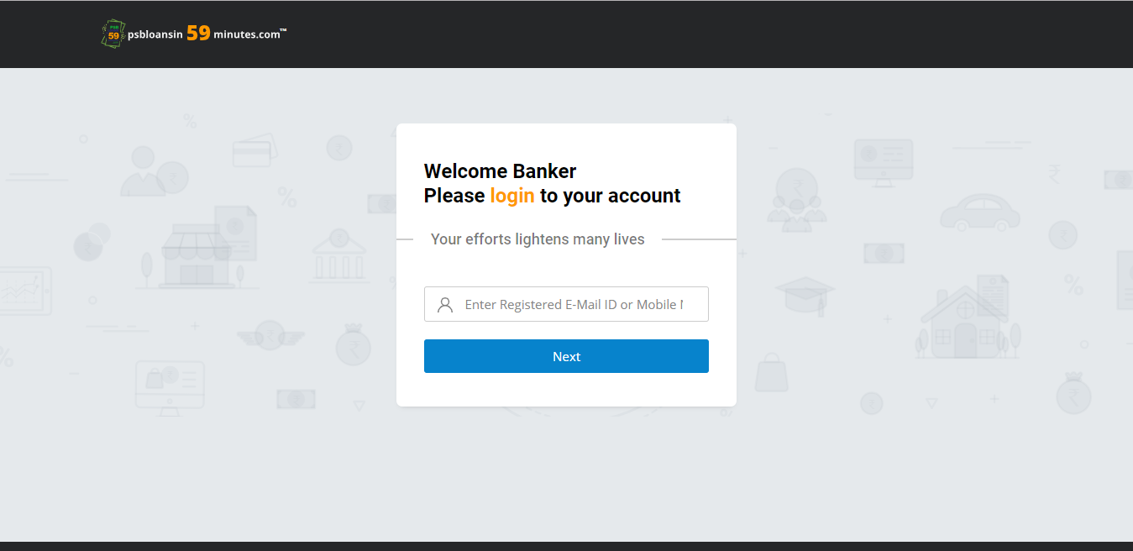
LOGIN
The URL is: https://www.psbloansin59minutes.com/banker

Slide 8
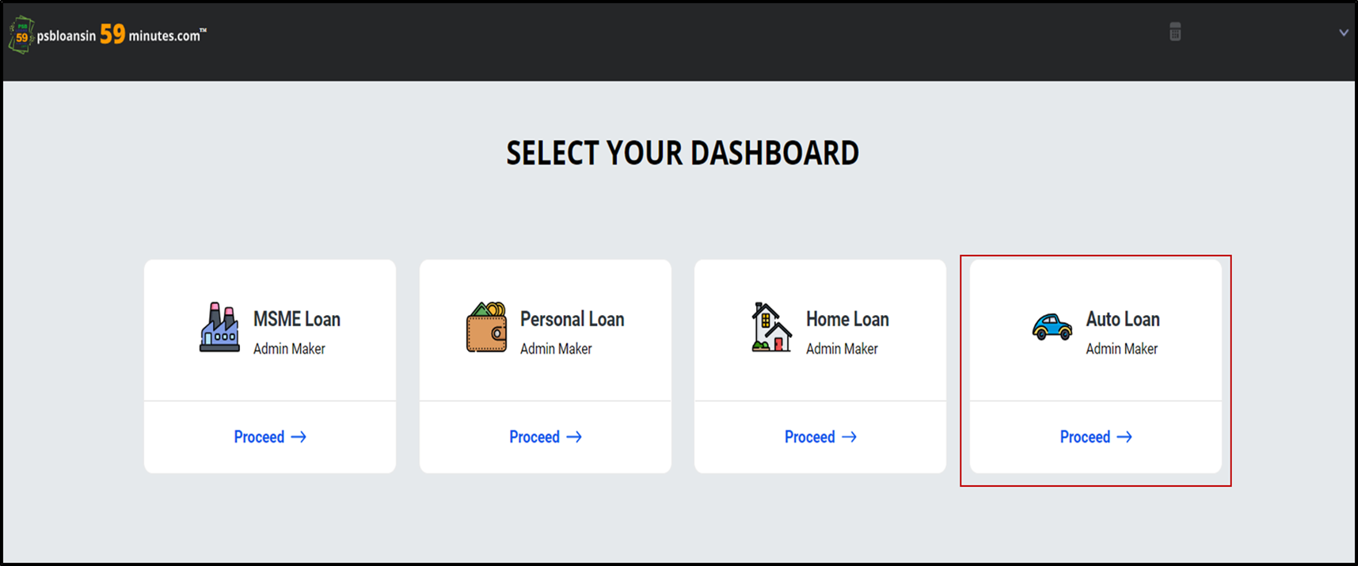
DASHBOARD
Lenders will select the dashboard based on the type of Proposal that they want to sanction.

Slide 9
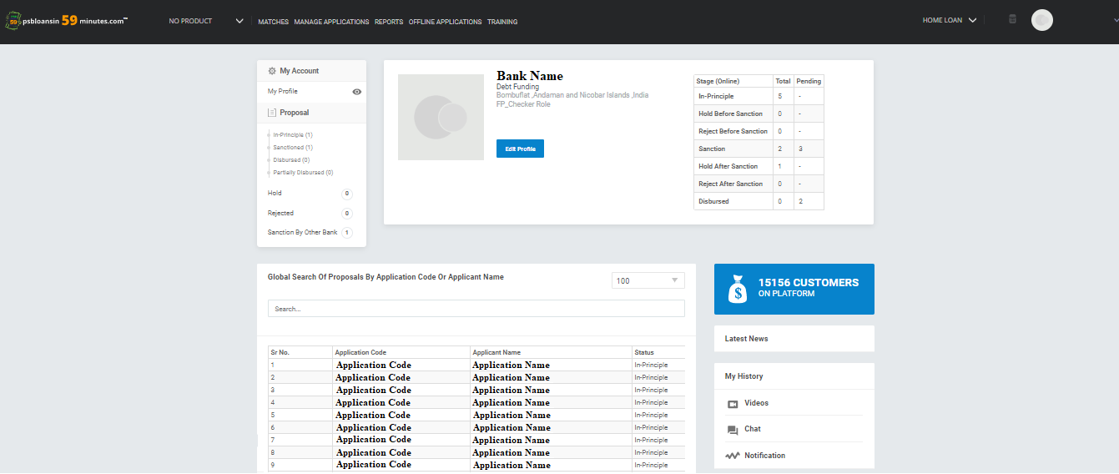

LANDING PAGE
Landing Page for Branch Checker.

Slide 10
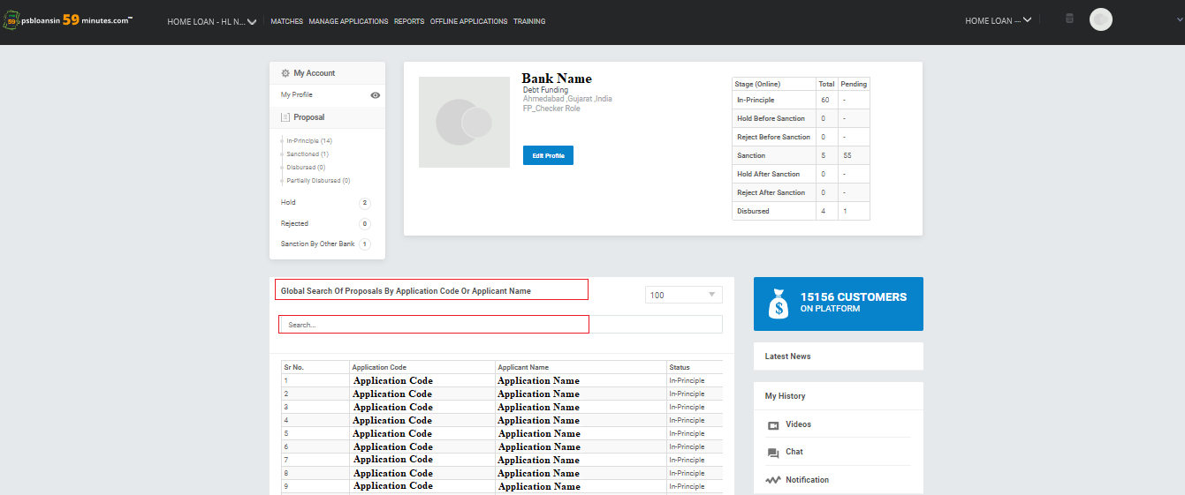
GLOBAL SEARCH
On Branch Office dashboard, Global search option is provided with which user can search any proposal received by the branch with application code/ applicant name.

Slide 11
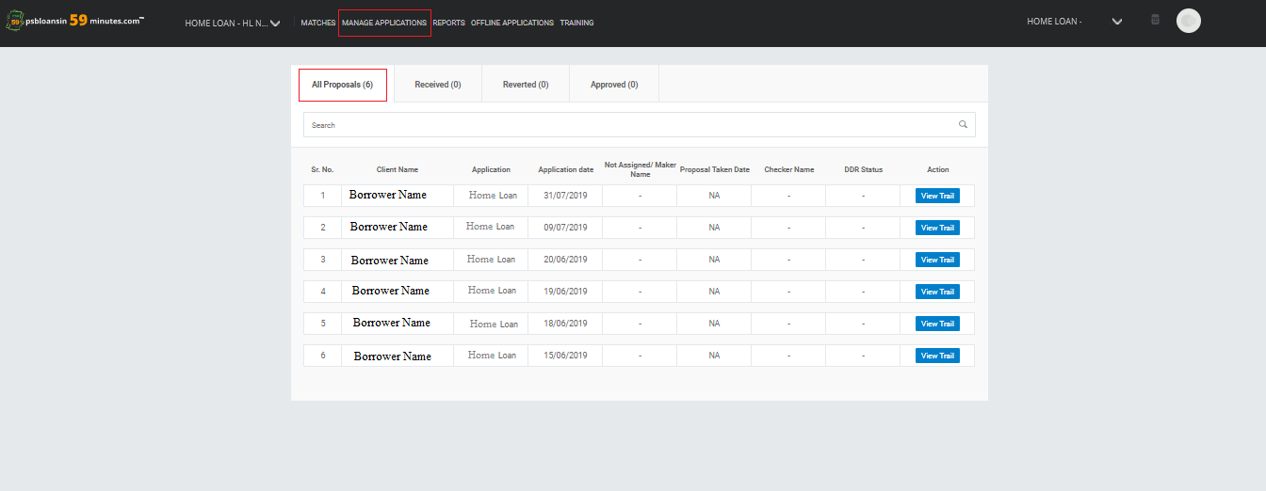
MANAGE APPLICATIONS - ALL PROPOSALS
Auto Loan
Auto Loan
Auto Loan
Auto Loan
Auto Loan
Auto Loan
The Branch Checker can see all the proposals tagged to that branch.

Slide 12
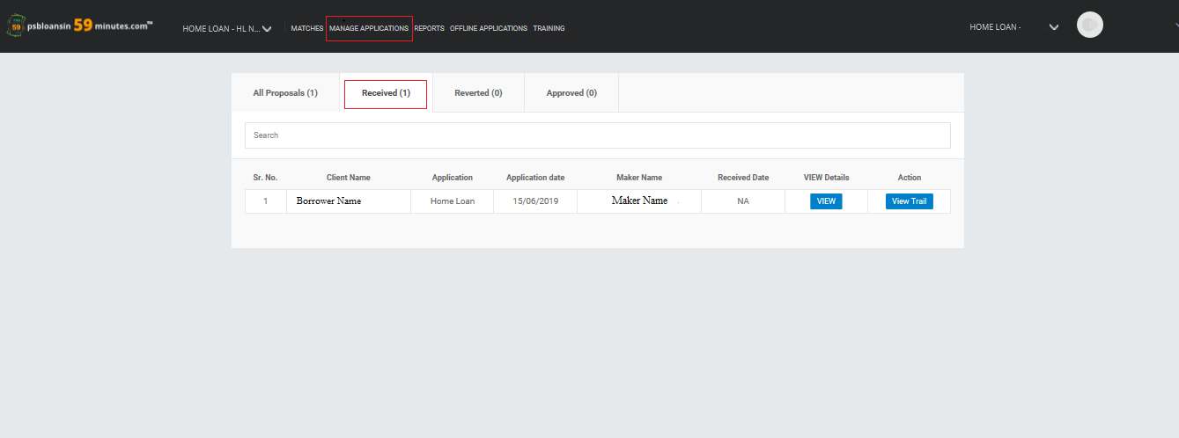
RECEIVED
Auto Loan
The Branch Checker can view the proposals that has been sent by the Branch Maker for DDR Approval.
The Branch Checker can view the Due Diligence Report sent by Maker.

Slide 13
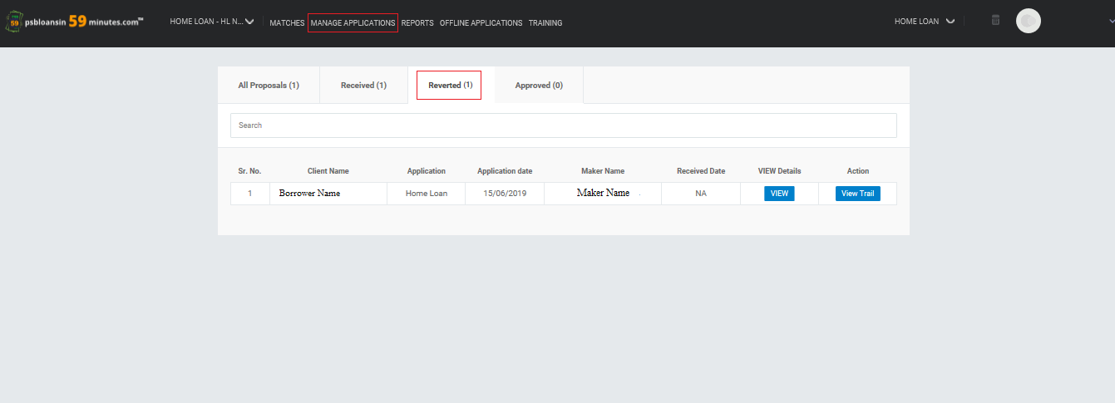
REVERTED
Auto Loan
All the proposals that are sent back to the Branch Maker by the Branch Checker for further due diligence are classified under the Reverted tab.

Slide 14
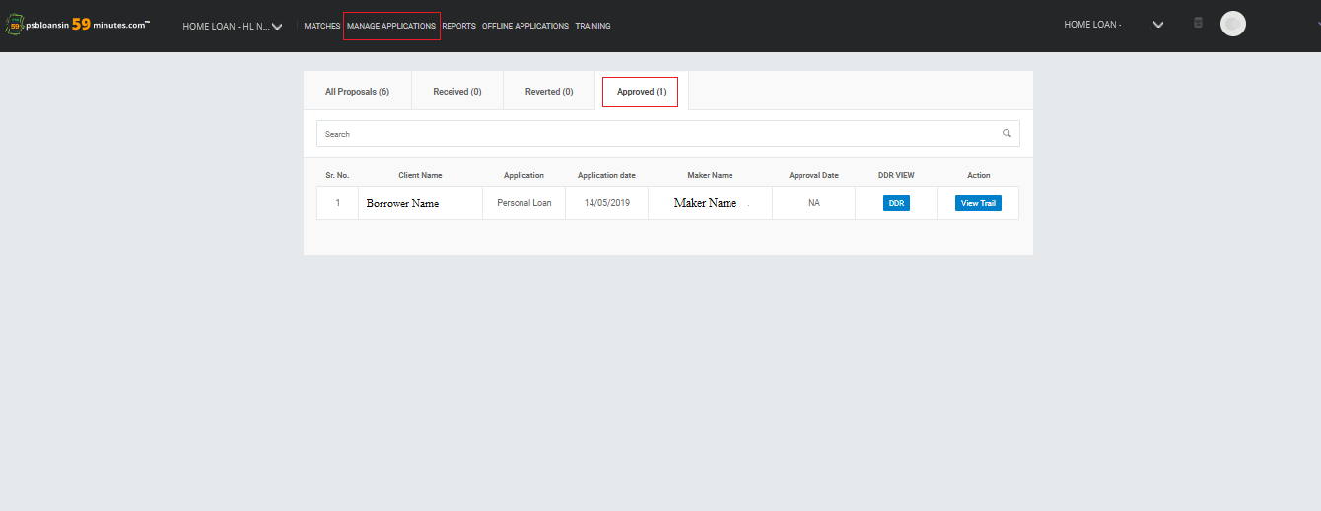
APPROVED
Home Loan
Auto Loan
Checker can see all the proposals whose DDR is approved by the Checker.

Slide 15
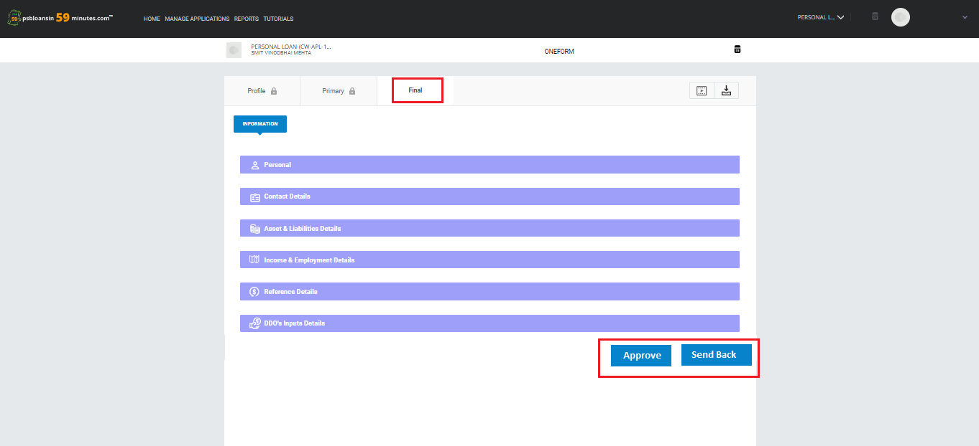
DDR APPROVAL
Auto Loan
Auto Loan
Borrower Name
Once the Checker clicks on DDR, Checker can Approve or send Back the proposal to the Maker

Slide 16
TEASER VIEW SCREENWISE WALK THROUGH

Slide 17
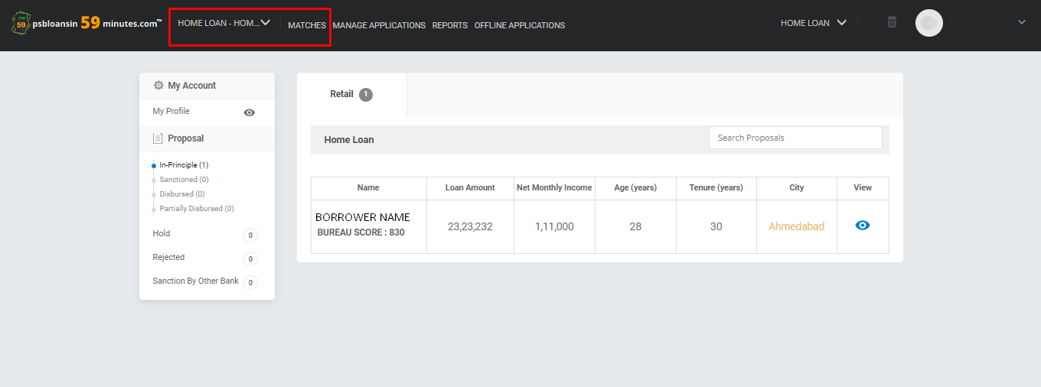
IN-PRINCIPLE APPROVED PROPOSALS
Auto Loan
Checker must select the product to view the proposals.
In-Principle (1) – Displays the In-Principle Proposals with the number of Proposals tagged to that Product.

Slide 18
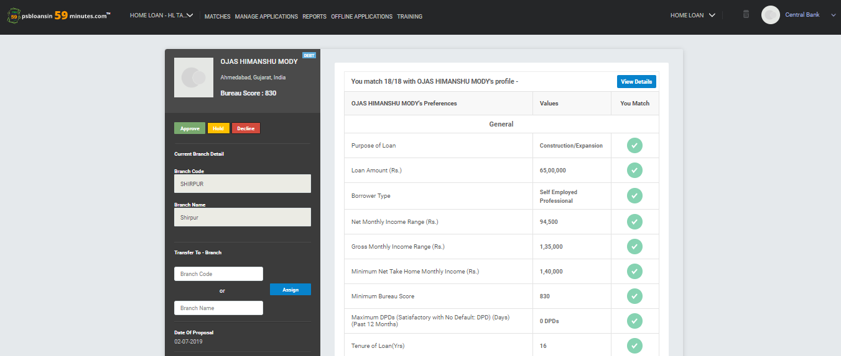

TEASER VIEW
HOME LOAN
You match 11/12 with Borrower Name’s Profile -
Borrower Name’s Preferences
Checker clicks on 'View Details' to view the proposal.

Slide 19
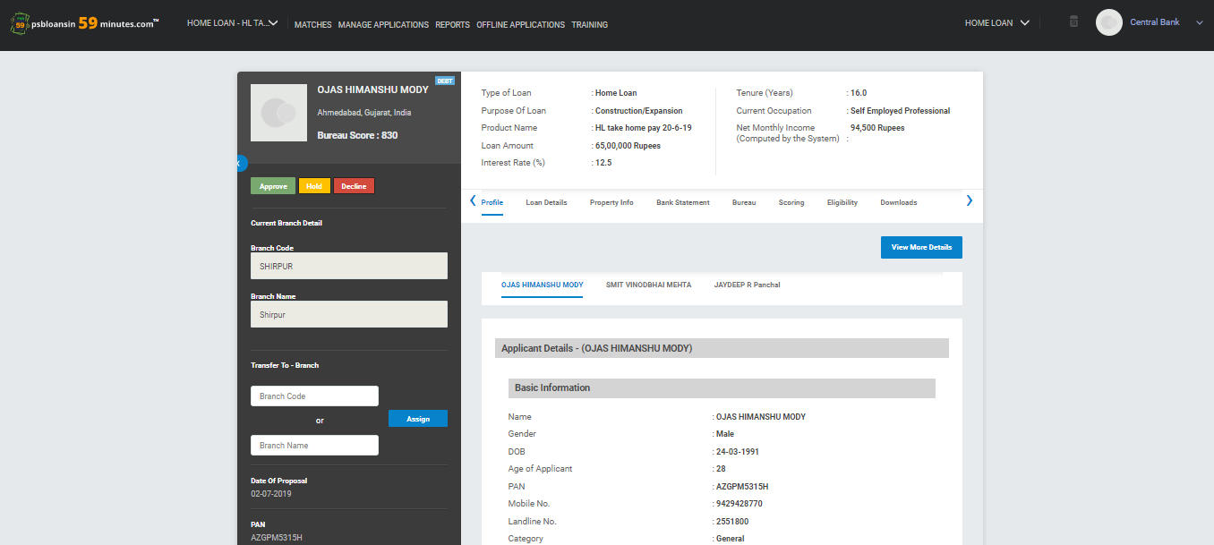
PROFILE
Auto Loan
Auto Loan
ABC
XYZ
ABC
The profile section allows the Branch Checker to view the profiles of the Applicant and the Co-Applicant.

Slide 20
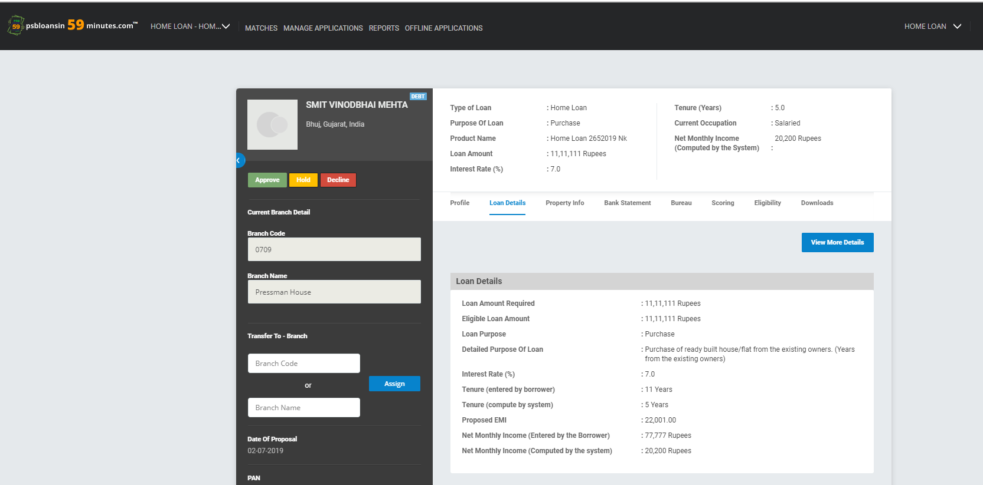
LOAN DETAILS
Borrower Name
Auto Loan
Borrower Name
Location
Location
Auto Loan
View the Loan Details of the Proposal.

Slide 21
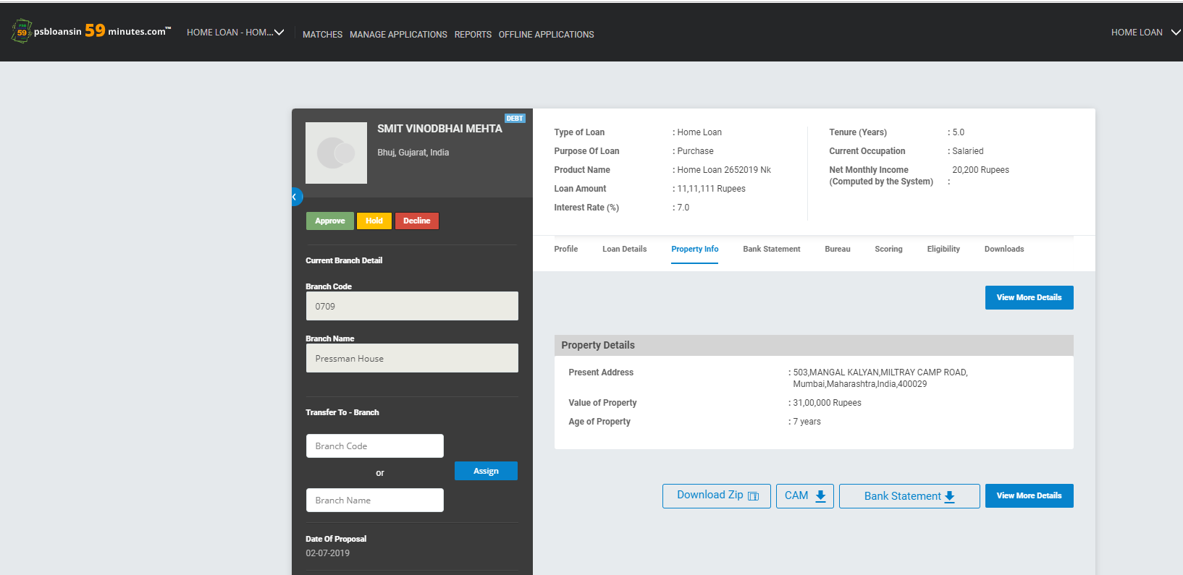
PROPERTY INFORMATION
Borrower Name
Auto Loan
Borrower Name
Location
Location
Auto Loan
View the Property Details of the Proposal.

Slide 22
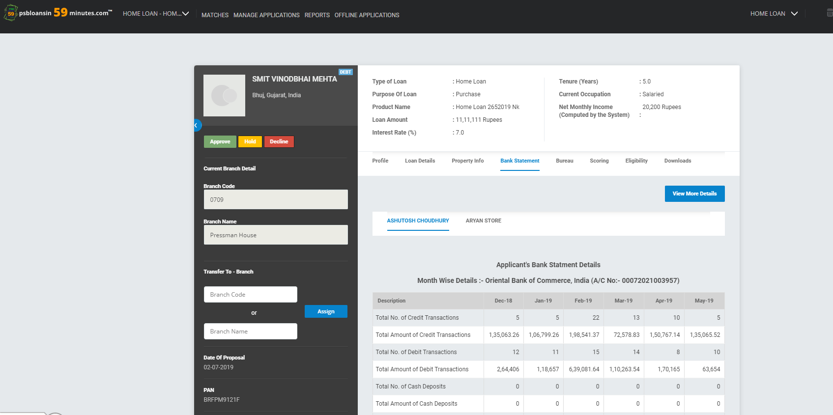
BANK STATEMENT ANALYSIS
Borrower Name
Auto Loan
Location
Auto Loan
ABC
XYZ
Bank Name (A/C No - )
View the Bank Statement Analysis of the Applicant as well as the Co-Applicant’s bank statements.

Slide 23
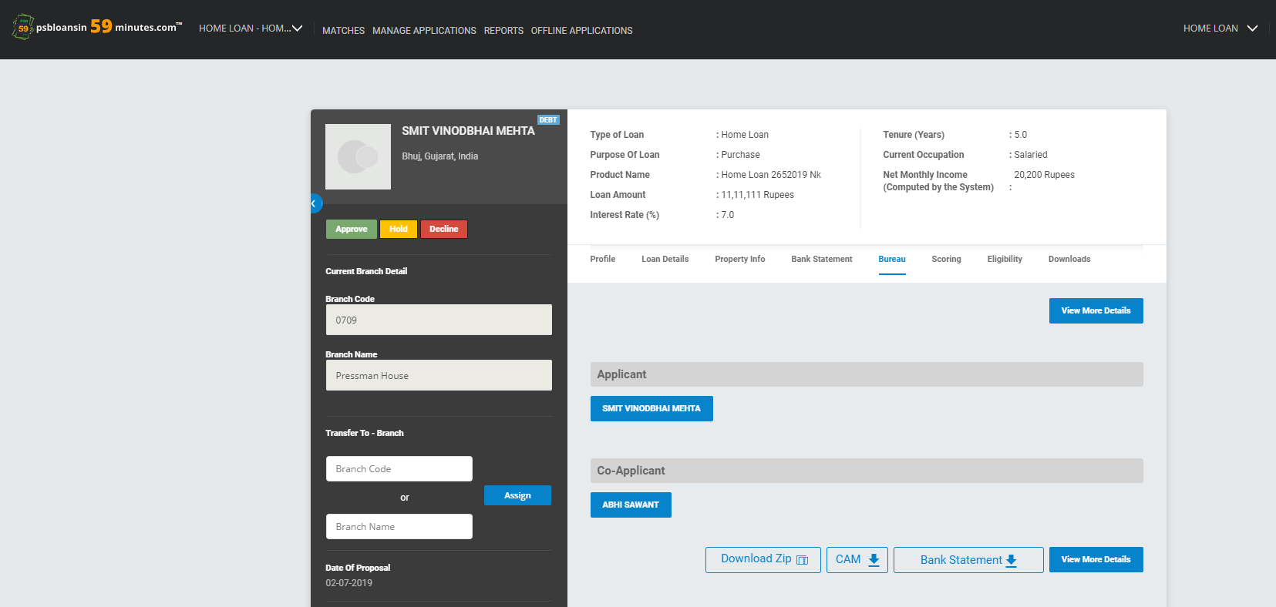
BUREAU
Borrower Name
Auto Loan
Location
Auto Loan
ABC
XYZ
View the bureau report of the Applicant and Co-Applicant.

Slide 24
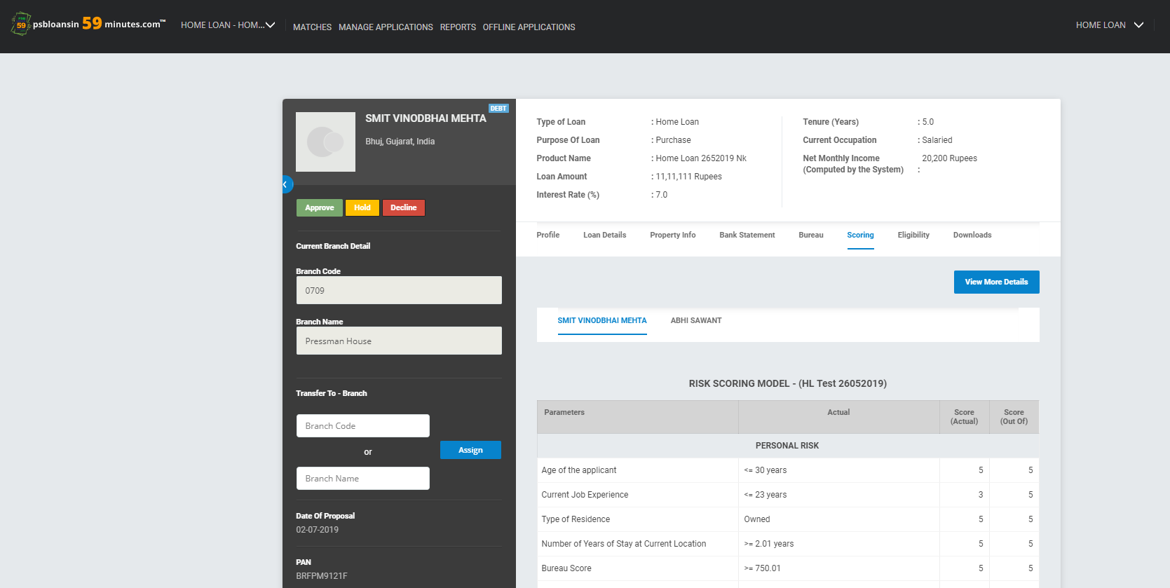
SCORING
Borrower Name
Auto Loan
Location
Auto Loan
ABC
XYZ
View the Scoring model and the score obtained by the borrower’s proposal under each criteria by the Applicant as well as the Co-Applicant.

Slide 25
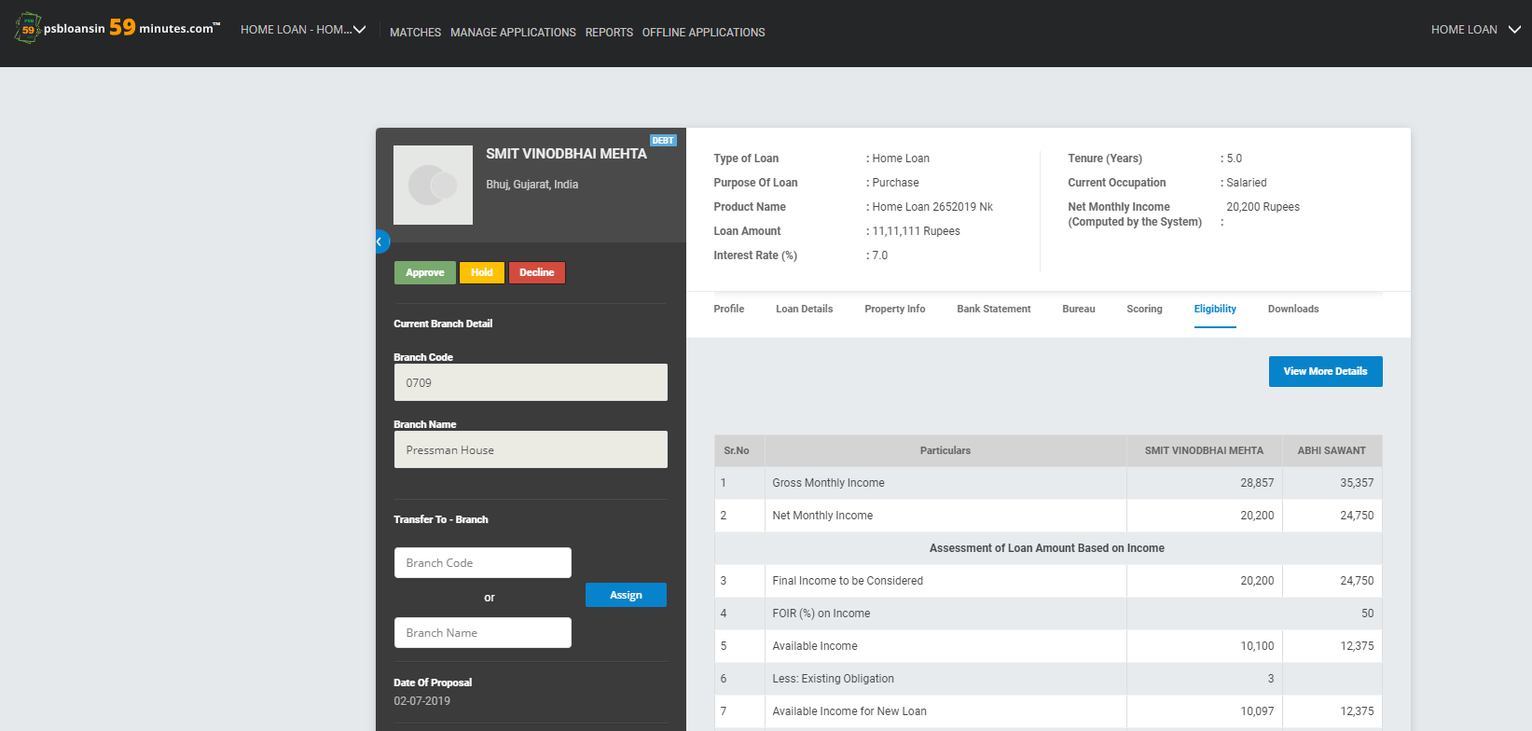
LOAN ELIGIBILITY AMOUNT
Borrower Name
Auto Loan
Location
Auto Loan
View the Loan Eligibility Amount Calculations of the Proposal.

Slide 26
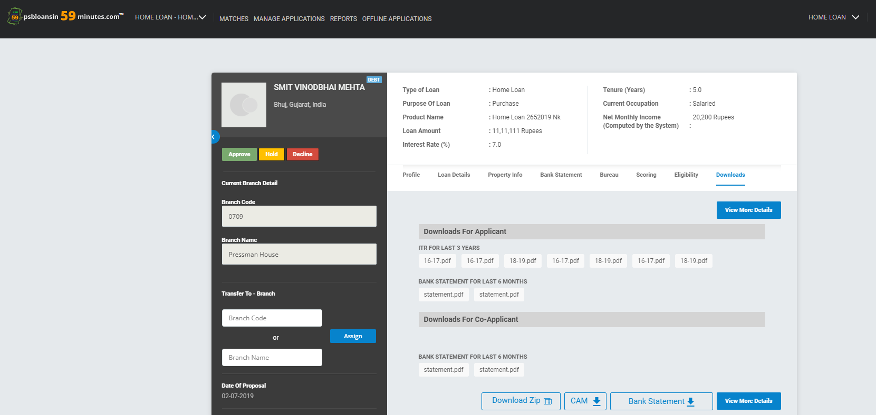
DOWNLOADS
Borrower Name
Auto Loan
Location
Auto Loan
Under the Download section, the Branch Checker can download all the documents provided by the borrower during the In-Principle Journey.

Slide 27
CAM REPORT DOWNLOAD
Borrower Name
Auto Loan
Location
Auto Loan
Checker can download the CAM report, Bank Statement (Month wise) and the other documents in ZIP file.

Slide 28
SANCTION/HOLD/REJECT A PROPOSAL SCREENWISE WALK THROUGH

Slide 29
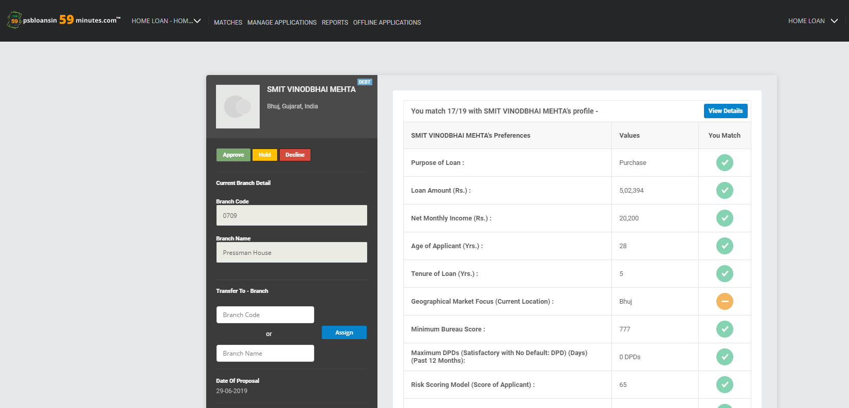
PROPOSAL VIEW
Borrower Name
Location
You match 11/12 with Borrower Name’s Profile -
Borrower Name’s Preferences
ABC
Checker clicks on Approve/Hold/Decline button to either approve, hold or decline a proposal directly from teaser view.
If the Branch Checker wants to put a proposal on Hold/Reject, he/she will have to provide a reason for the action.

Slide 30
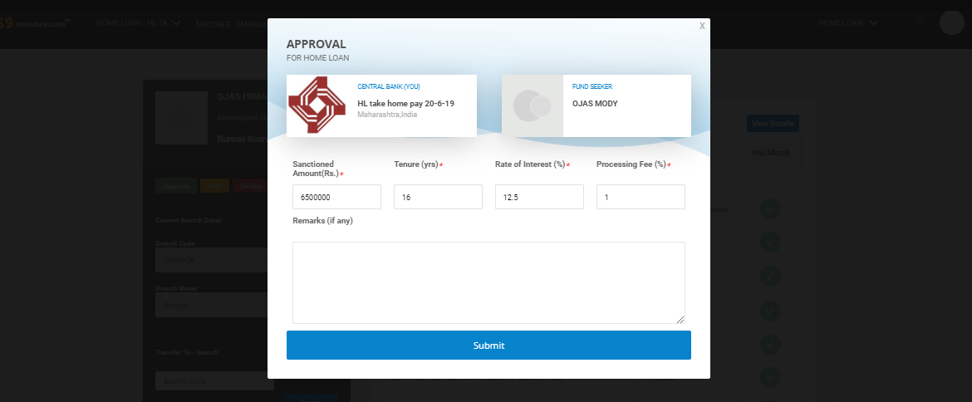
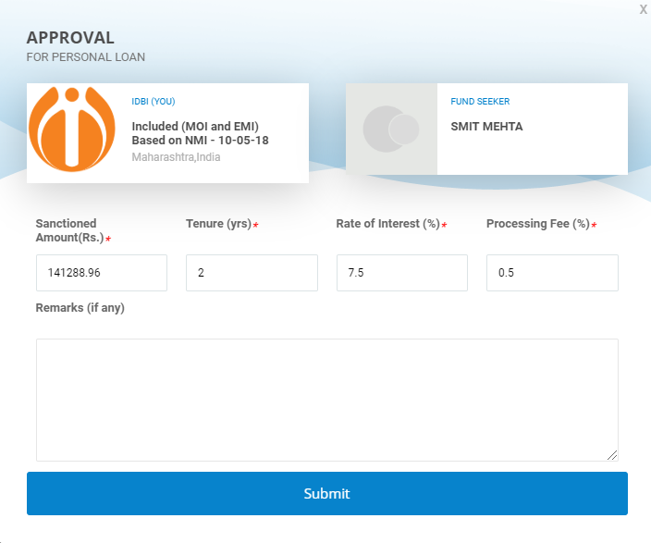
SANCTION/APPROVAL
Auto Loan
LENDER
BORROWER
Auto Loan
To sanction a proposal, the Branch Checker will click on 'Approve', a pop up is shown to fill the required details to sanction the proposal.

Slide 31
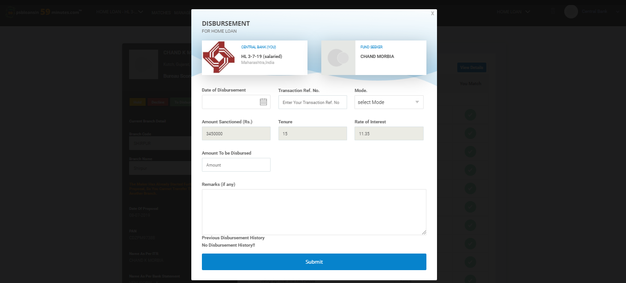
DISBURSEMENT
Auto Loan
LENDER
BORROWER
FUND PROVIDER
Auto Loan
To disburse a proposal, the Branch Checker will click on 'To Disburse', a pop up is shown to fill the required details to disburse the proposal.

Slide 32
BRANCH TRANSFER SCREENWISE WALK THROUGH

Slide 33
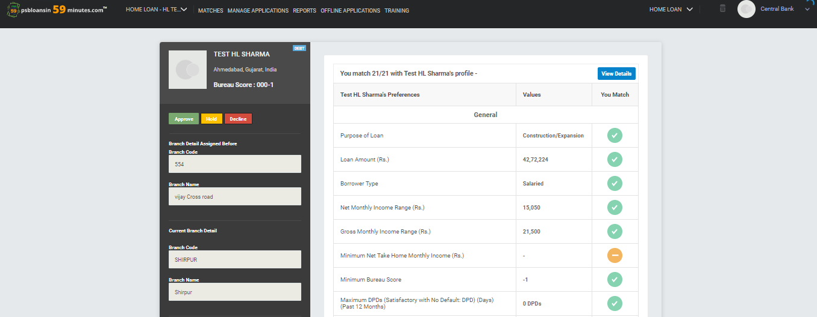
PROPOSAL VIEW
HOME LOAN
Borrower Name
You match 11/12 with Borrower Name’s Profile -
Location
You match 11/12 with Borrower Name’s Profile -
Borrower Name’s Preferences
Borrower Name’s Preferences
If any borrower has selected incorrect branch or selected a branch which is far away from borrower’s location then the selected Branch Checker has an option to transfer that proposal to a correct or nearby branch.

Slide 34
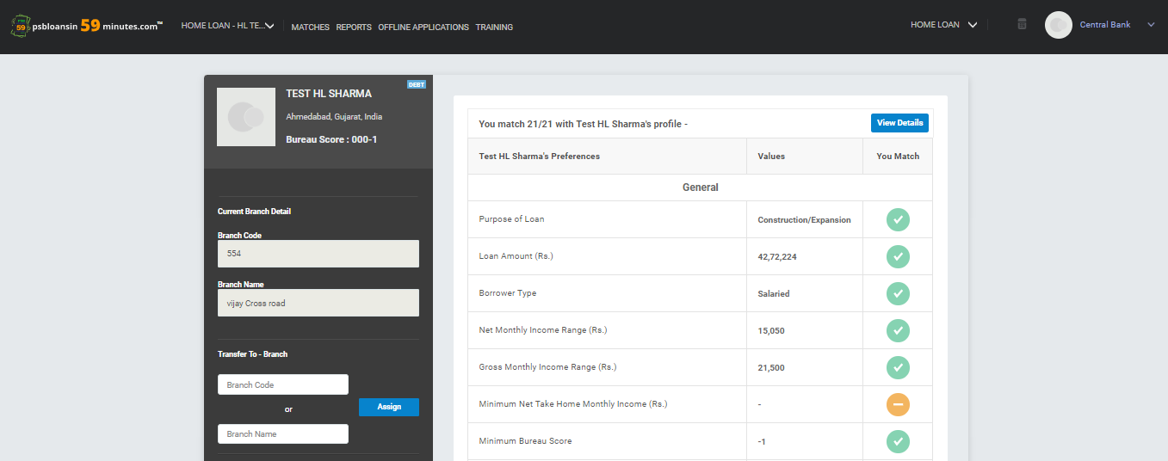
TRANSFER BRANCH
You match 11/12 with Borrower Name’s Profile -
Borrower Name’s Preferences
To transfer branch of any proposal, fill the proposed branch details in “Transfer To – Branch” and branches created for bank will be shown as suggestion. Select proposed branch where you want to transfer and click on assign.
Note : Proposal can be transferred only if Branch Maker has not started any process for that proposal. Also proposal can be transferred only at In-Principle stage, if any decision/action is taken then such proposal can not be transferred.

Slide 35
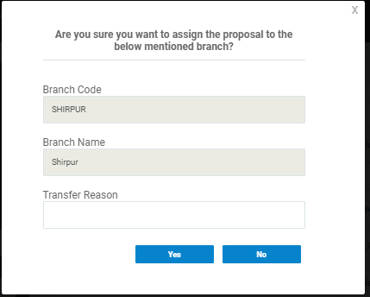
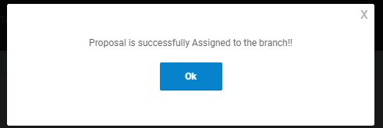
TRANSFER BRANCH
On clicking on assign, confirmation pop up will be shown and clicking on “yes”, said proposal will be transferred to proposed branch.
Note : Transferred proposals will only be shown in transferred branch and will not be shown in branch from which proposal is transferred.

Slide 36
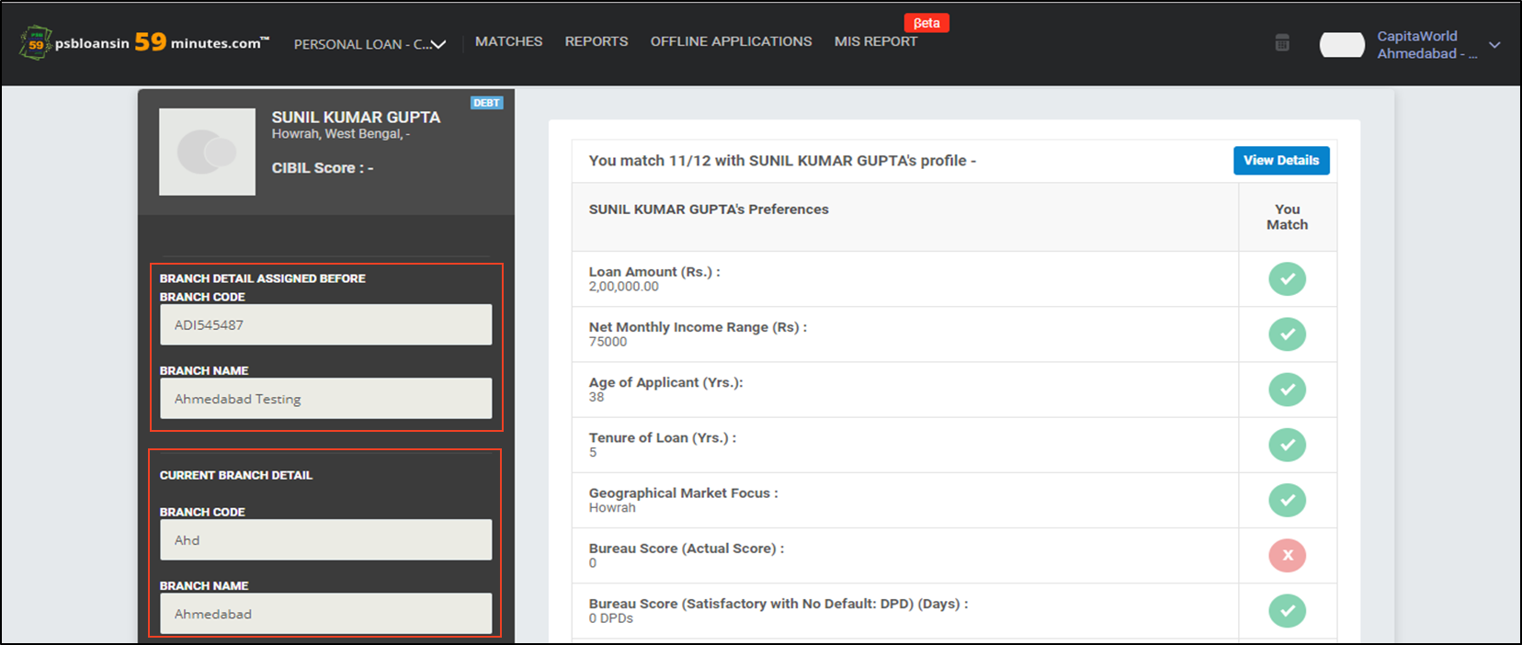
PROPOSAL VIEW IN TRANSFERRED BRANCH
HOME LOAN
Borrower Name
Location
You match 11/12 with Borrower Name’s Profile -
Borrower Name’s Preferences
Previous branch details (branch who has transferred proposal)
Current branch details
In transferred branch, details of branch which has transferred proposal along with current branch details will be shown. Now proposed Branch Maker / Checker can continue their journey on said proposal.

Slide 37
OFFLINE PROPOSALS SANCTION/ DISBURSEMENT

Slide 38
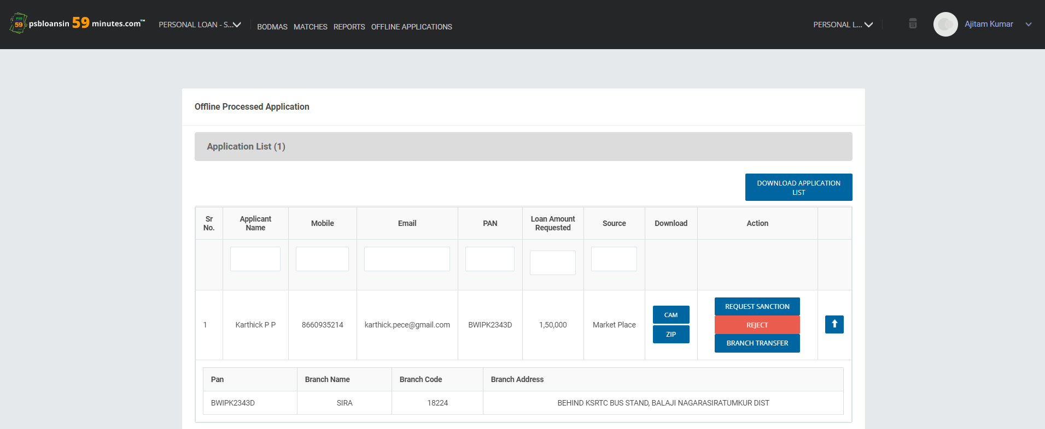
Offline Proposals
HOME LOAN
HOME LOAN
Landing Page for offline proposals.
Notes:
New screen shot

Slide 39
Application List
HOME LOAN
HOME LOAN
Once clicked on 'Offline Applications’, Branch Checker can view the CAM report, download the zip file and Reject or Sanction the proposal from the Application List. Branch Checker can also Transfer the proposal to another Branch. If clicked on 'Reject' then Branch Checker has to fill the reason for rejection
Notes:
New screen shot

Slide 40
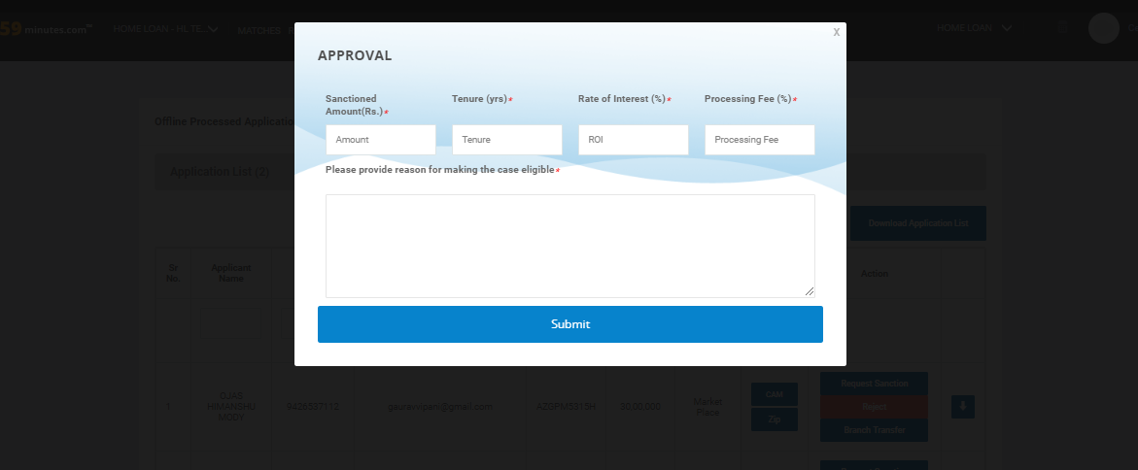
Sanction of Offline Proposals
Once the Branch Checker clicks on 'Request Sanction', the Approval pop up is shown
Notes:
New screen shot

Slide 41
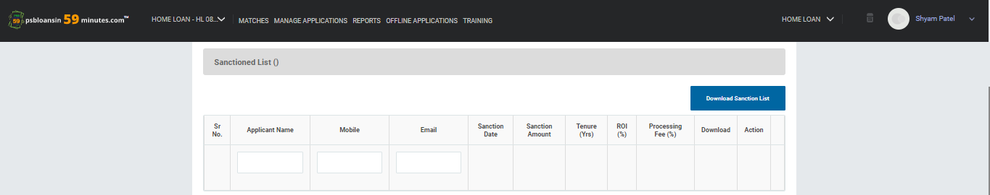
Sanctioned Proposals
Once the Offline Proposal is approved, the Proposal shifts to the 'Sanctioned List’. Branch Checker can click on 'Request Disbursement' to disburse the Proposal.
Notes:
New screen shot

Slide 42
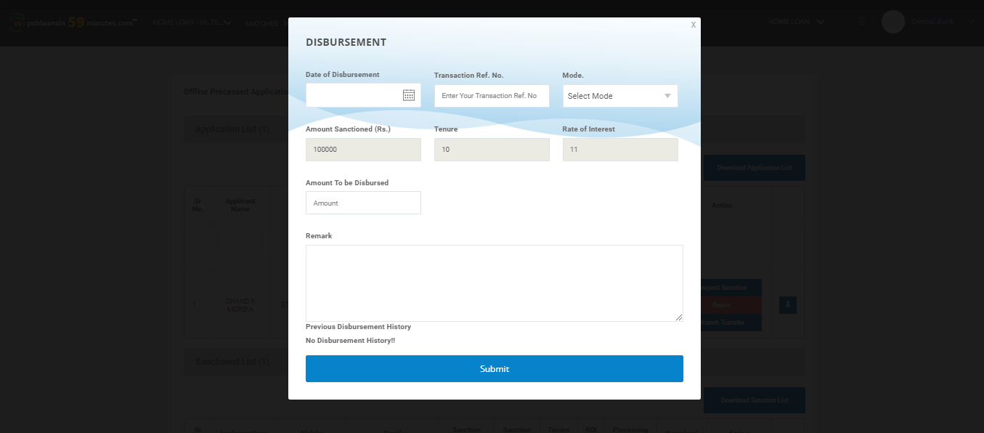
Disbursing Proposals
Once the Branch Checker clicks on 'Request Disbursement', the Disbursement pop up is shown
Notes:
New screen shot

Slide 43
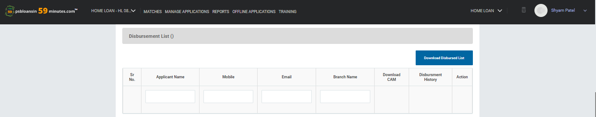
Disbursed Proposals
Once the Offline Proposal is disbursed, the Proposal shifts to the 'Disbursement List’.
Notes:
New screen shot

Slide 44
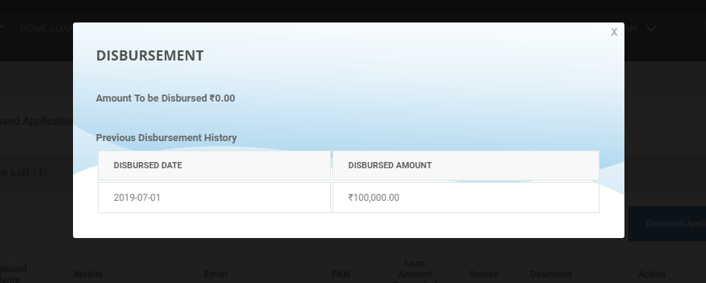
View Disbursement History
When Branch Checker clicks on 'View Disbursement History'
Notes:
New screen shot

Slide 45
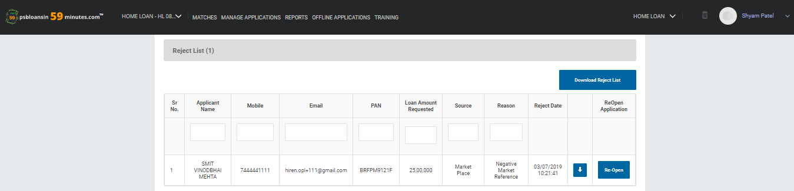
Reject list
If Branch Checker Rejects the proposal from ‘Application List’, the proposal shifts to the 'Reject List'

Slide 46
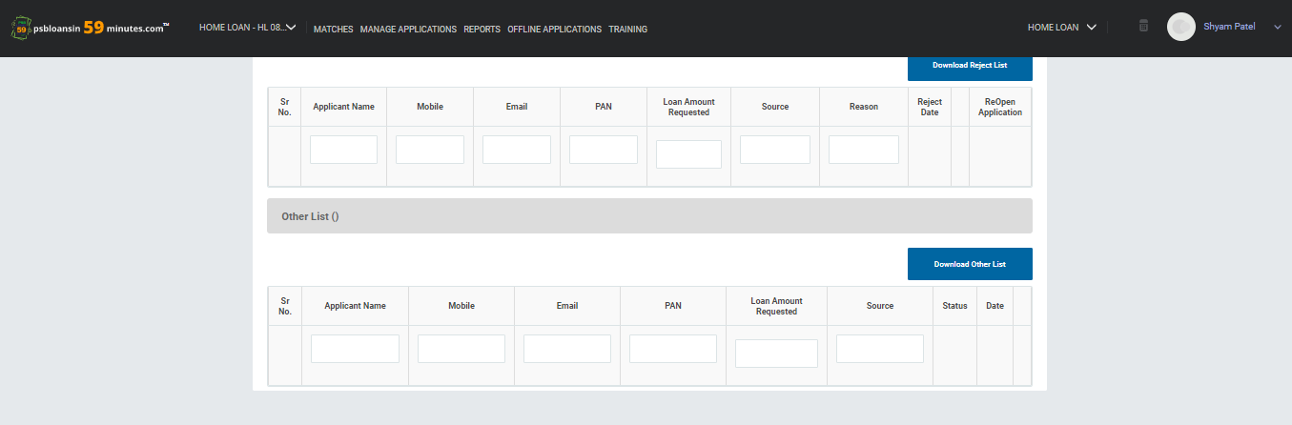
Other List
List of proposals that have moved to other bank.
Notes:
New screen shot

Slide 47
THANK YOU
Mail us at :
Borrower Journey Queries: support@psbloansin59minutes.com
Banker Journey Queries: banksupport@psbloansin59minutes.com
Customer Helpline No: 079-41055999

